Slide 1



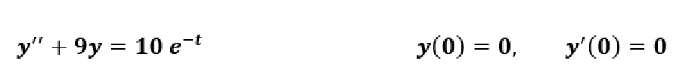


Applied Mathematics
Computer Engineering Department
Lec.One
So, The derivative property of the laplace transform is:
Ans:
e-t

Slide 2


Applied Mathematics
Computer Engineering Department
Lec.One

Slide 3




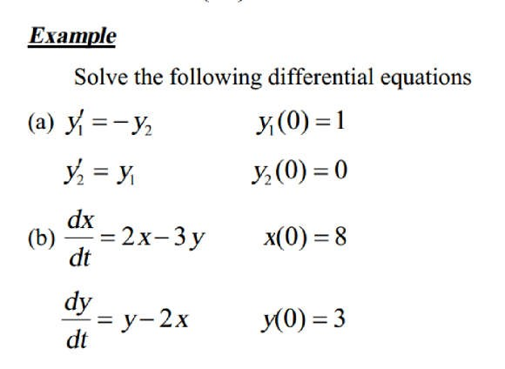
Applied Mathematics
Computer Engineering Department
Lec.One

Slide 4






Applied Mathematics
Computer Engineering Department
Lec.One

Slide 5







Applied Mathematics
Computer Engineering Department
Lec.One

Slide 6
Applied Mathematics
Computer Engineering Department
Lec.Two
Homework
Solve The following D.E:
1) 𝟒𝒚′′ + 𝝅^{𝟐}𝒚 = 𝟎
𝒚 𝟎 = 𝟐,
Ans: 𝟐𝒄𝒐𝒔 _{𝟐} 𝒕
𝒚 𝟎 = 𝟐. 𝟖,
Ans: 𝟐. 𝟖𝒆^{−𝟒𝒕}
𝒚′ 𝟎 = 𝟎
𝝅
2) 𝒚′ + 𝟒𝒚 = 𝟎
3) 𝒚′′ − 𝒌𝒚′ = 𝟎
𝒚 𝟎 = 𝟐
Ans: 𝒖 𝒕 + 𝒆^{𝒌𝒕}
𝒚 𝟎 = 𝟒,
Ans: 𝟒𝒄𝒐𝒔𝒉 _{𝟐} 𝒕
𝒚 𝟎 = 𝟎,
𝒚′ 𝟎 = 𝒌
4) 𝒚′′ − ^{𝟏} 𝒚 = 𝟎
𝒚′ 𝟎 = 𝟎
𝟒
𝟏
5) 𝒚′′ + 𝒚′ − 𝟐𝒚 = 𝟎
𝒚′ 𝟎 = 𝟏
𝟏 𝟏
Ans: 𝒆^{𝒕} − 𝒆^{−𝟐𝒕}
𝟑 𝟑
6) 𝒚′ + 𝟐𝒚
= 𝟏𝟕𝒔𝒊𝒏(𝟐𝒕)
𝒚 𝟎 = 𝟏,
Ans:
7) 𝒚′′ + 𝒚′ − 𝟐𝒚 = 𝒆^{−𝒕}
𝒚 𝟎 = 𝟎,
𝒚′ 𝟎 = 𝟎
Ans: − ^{𝟏} 𝒆^{−𝒕} + ^{𝟏} 𝒆^{−𝟐𝒕} + ^{𝟏} 𝒆^{𝒕}
𝟐 𝟑 𝟔
= 𝒚_{𝟏}𝒚_{𝟏} 𝟎 = 𝟖, 𝒚_{𝟐} 𝟎 = 𝟎
Ans: 𝒚_{𝟏} 𝒕 = 𝟖𝒄𝒐𝒔𝒉𝒕, 𝒚_{𝟐} 𝒕 = 𝟖𝒔𝒊𝒏𝒉𝒕
8) 𝒚′ = 𝒚_{𝟐},
_{𝒚}′
𝟏 𝟐
9) 𝒚′ + 𝒚_{𝟐} = 𝟐𝒄𝒐𝒔 𝒕 , 𝒚′ + 𝒚_{𝟏} = 𝟎
𝟏 𝟐
𝒚_{𝟏} 𝟎 = 𝟎, 𝒚_{𝟐} 𝟎 = 𝟏
Ans: 𝒚_{𝟏}(𝒕) =sint
10) ^{𝒅𝒙} = 𝟓𝒙 + 𝟑𝒚 𝒙 𝟎 = 𝟒
𝒅𝒕
^{𝒅𝒚} = 𝒚 − 𝒙 = 𝟑𝒚
𝒚 𝟎 = 𝟖
𝒅𝒕
6
Assist lect.: Weaam T. Ali

